Slide 1
PHD Progression 11
Explainable AI with visual analytics

Slide 2

Things accomplished
RapidMiner installed
I started playing around with d3.js and have seen how it connects to the HTML file
Industry visualization requirements
Skills needed to complete this project
Studied several papers

Slide 3
Industry visualization requirements(Attention Mechanism)
Attention Heatmaps: These are essential for identifying which parts of the input the model finds most relevant for predictions.
Bipartite Graph Representation: This is used to analyse how attention flows within a specific layer and to identify patterns between heads.
Attention-based saliency Maps(for vision Transformers): Visualizes the important regions of an image that led to a specific classification, often using techniques like Layer-wise Relevance Propagation (LRP).

Slide 4
Industry visualization( Model structure & Flow visualization)
Sankey Diagram/Flow Visualization: Shows the flow of data through the model’s components, such as self-attention and MLP blocks
Layer-wise visualization: Allows for the analysis of attention patterns across different layers
Interactive Computational Graphs: Visualizes the “inner workings” of the transformer

Slide 5

Industry visualization (Interpretability & Debugging Tools)
Head importance Metrics: Visualizes which attention heads have the highest impact on the final output.
Attention Strength Vector (Spatial Distribution): Profiles how patches attend to near/far neighbors, which is crucial for understanding 2D spatial context in Vision Transformers (ViT).
Clustering & Pattern Analysis: Uses techniques like t-SNE to cluster similar attention patterns
Vocabulary Projection: Projects weights and hidden states of LLMs to their vocabulary, making them more interpretable.

Slide 6

Skills needed to complete this project
HTML/CSS/JavaScript
Vue + Typescript
Flask REST APIs
D3.js
Docker
AWS deployment
Gunicorn setup
Data Structures and algorithm

Slide 7

Transformer Visualization via Dictionary learning
Explainable AI with visual analytics

Slide 8
Introduction
Current technique used to interpret transformers is “Probing task”. This is done by attaching a light-weight auxiliary classifier at the output of the target transformer layer.
The auxiliary classifier is then trained on well-known NLP tasks like part-of-speech (POS) tagging, Named-entity recognition (NER) Tagging, syntactic Dependency

Slide 9
The limitations of probing tasks
POS and NER are too simple.
Probing tasks can only verify whether a certain prior structure is learned in a language model.
It’s hard to locate where exactly the related linguistic representation is learned in the transformer

Slide 10


The limitations of probing tasks
The paper hypothesizes that contextualized word embedding as a sparse linear superposition of transformer factors.
By the hypothesis, embedding vector x ∈ X is a sparse linear superposition of transformer factor

Slide 11
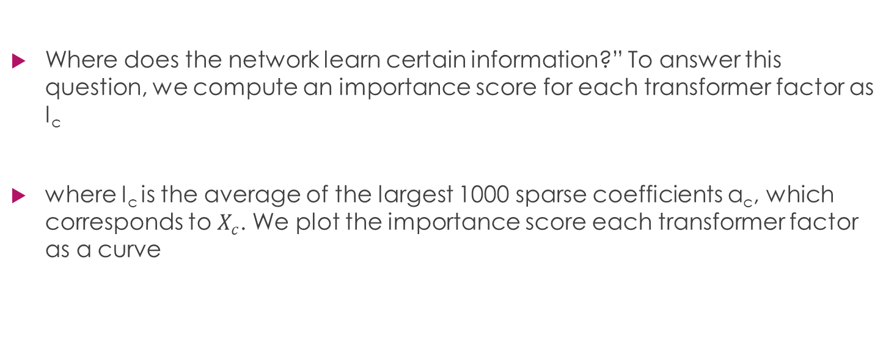
Introduction
Where does the network learn certain information?” To answer this question, we compute an importance score for each transformer factor as I_{c}
where I_{c} is the average of the largest 1000 sparse coefficients α_{c}, which corresponds to $X_{c}$. We plot the importance score each transformer factor as a curve

Slide 12
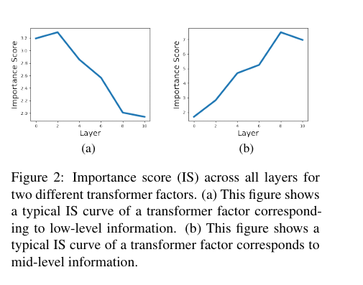
The importance score vs layer graph

Slide 13
Experiments and discoveries
We use a 12-layer pre-trained BERT model and freeze the weights.
Since we learn a single dictionary of transformer factors for all of the layers in the transformer,
we show that these transformer factors correspond to different levels of semantic or syntactic patterns. word-level disambiguation, sentence-level pattern formation, and long-range dependency.

Slide 14
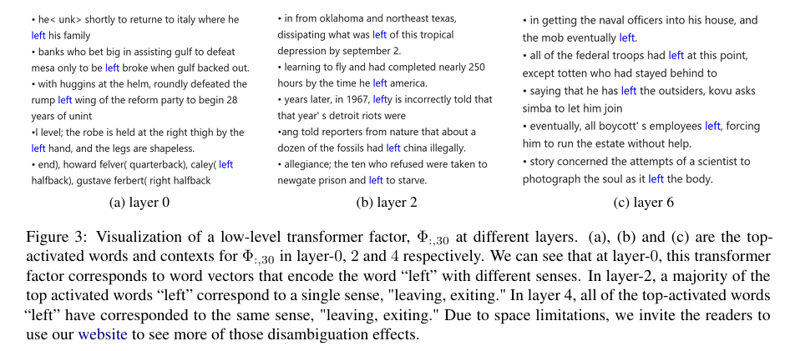
Low-Level: Word-level polysemy disambiguation
While the input embedding of a token contains polysemy, we find transformer factors with early IS curve peaks usually correspond to a specific word-level meaning.
By visualizing the top activation sequences, we can see how word-level disambiguation is gradually developed in a transformer.

Slide 15
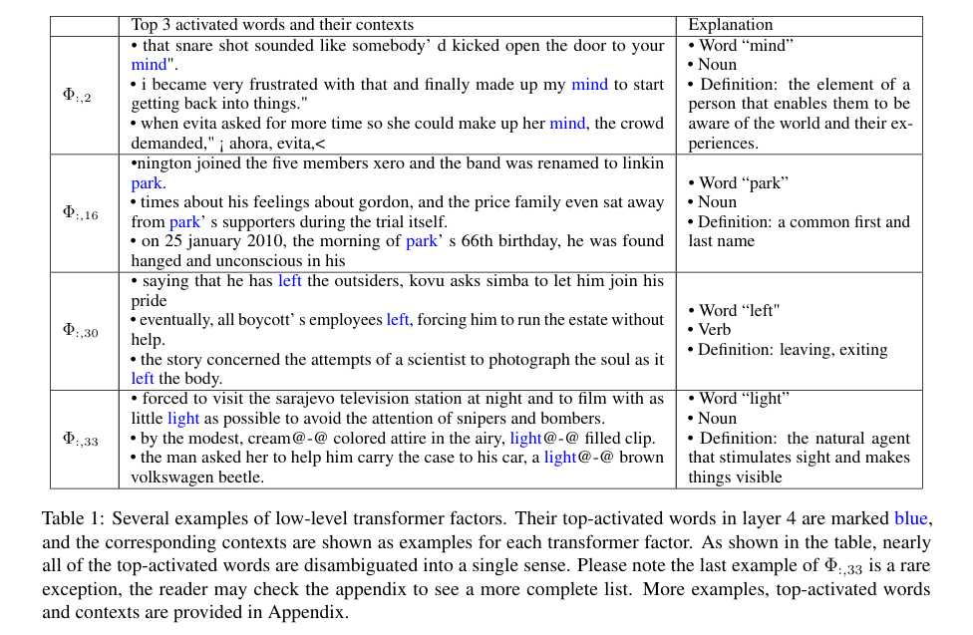

Slide 16
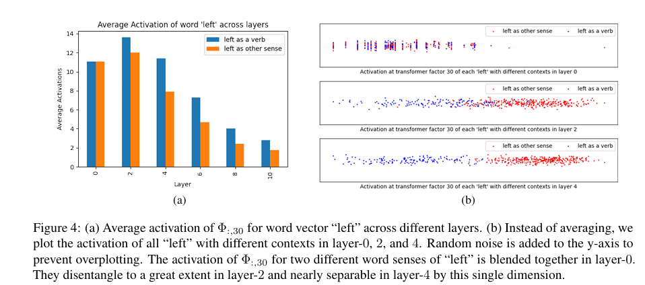
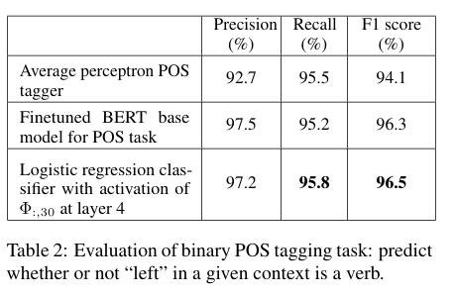

Slide 17
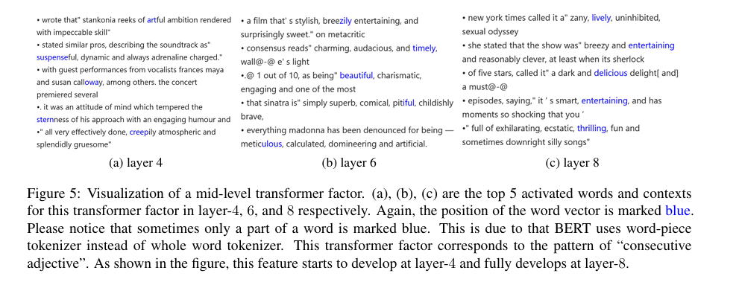
Mid-level: sentence-level pattern formation
Midlevel ones correspond to semantic patterns like phrases and sentences pattern.
This pattern starts to emerge at layer 4, develops at layer 6, and becomes quite reliable at layer 8.

Slide 18
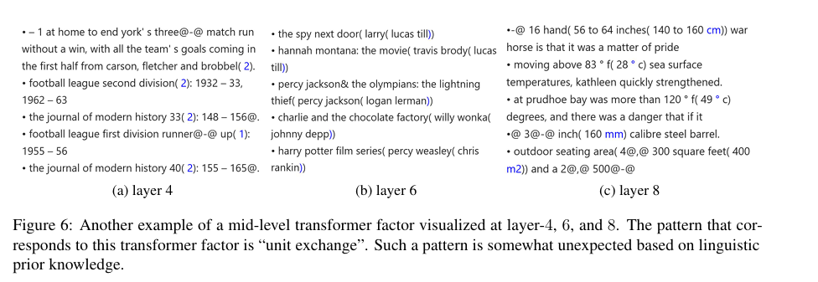
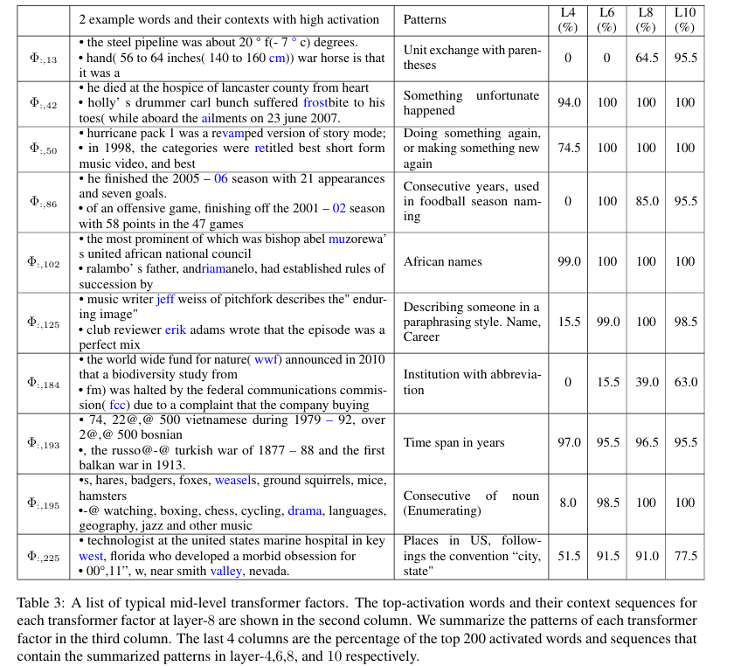

Slide 19
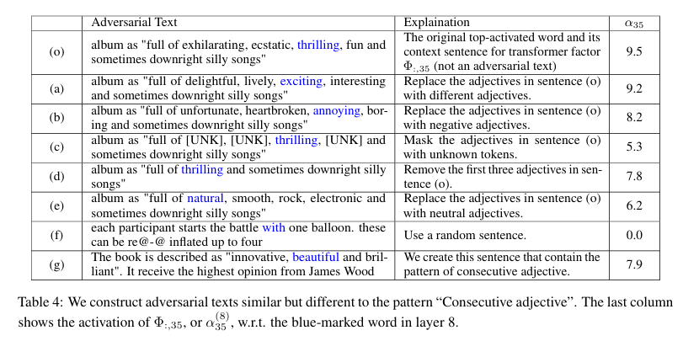

Slide 20
High-level: Long range dependency
High-level transformer factors correspond to those linguistic patterns that span an extended range in the text.
This paper makes use of LIME to ease the process of identifying the contribution of each token in the sequence.

Slide 21
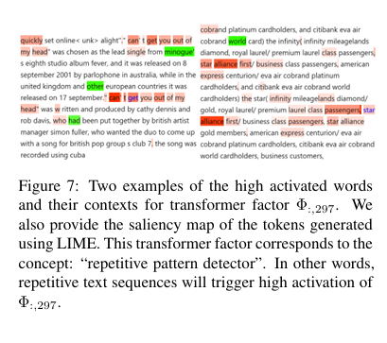
High-level: Long range dependency
the color reflects the weights w at each position.
Red means the given position has positive weight and green means negative weight. T
he magnitude of weight is represented by the intensity.

Slide 22
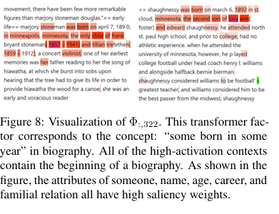
Figure 8 shown another high-level factor, which detects text snippets related to “the beginning of a biography”.
The necessary components, day of birth as month and four-digit years, first name and last name, familial relation, and career, are all midlevel information.

Slide 23

InterpreT: An interactive visualization Tool for interpreting Transformers

Slide 24
InterpreT
The system flow consists of two major stages: offline extraction of the model specific and task specific information such as targets, predictions, relevant hidden states, and attention matrices and running the application itself.
During the offline stage the extracted hidden states are preprocessed using t-SNE before being saved to a file.

Slide 25
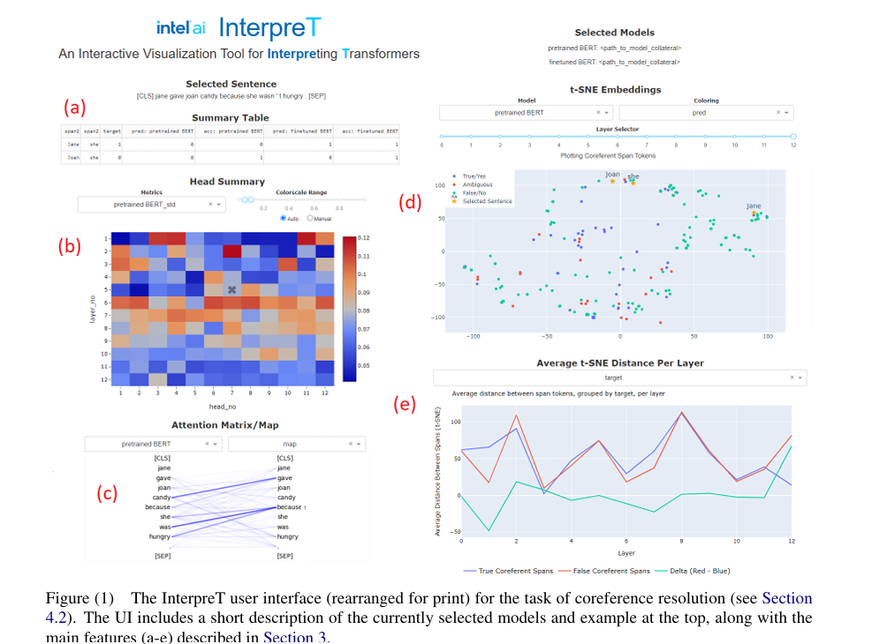
The different views of InterpreT

Slide 26
Attention head summary: InterpreT includes a head summary plot that displays attention head summary statistics for each head and layer.
Attention matrix correlation: obtained by computing the correlation between an attention matrix and an arbitrary, same-size matrix.
Task-specific attention intensity: a “coreference intensity” metric is devised to pinpoint attention heads with an affinity for identifying coreference relationships

Slide 27
Attention matrix/maps: InterpreT provides the ability to display the attention patterns and weights exhibited by specific attention heads, which can be selected by clicking on a specific head and layer in the head summary plot.
Average T-SNE Distance Per Layer: To complement t-SNE visualization of the hidden states, InterpreT also introduces a novel plot showing the average t-SNE space distance between specific groups of terms across all the Transformers’ layers

Slide 28
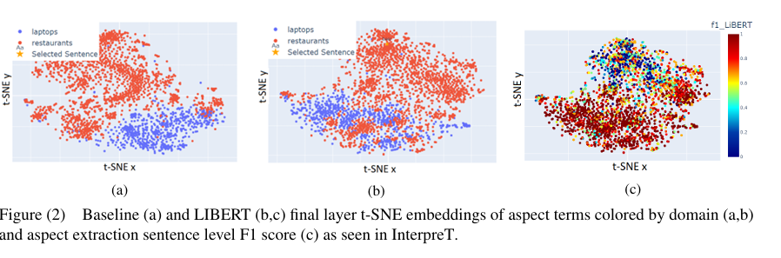
Use cases
Cross domain aspect-based sentiment analysis: A fundamental task in fine-grained sentiment analysis is the extraction of aspect and opinion terms.
in the sentence “The chocolate cake was incredible”, the aspect term is chocolate cake, and the opinion term is incredible.
LIBERT and the Baseline model achieved aspect extraction F1 scores of 0.5143 and 0.4254 respectively

Slide 29
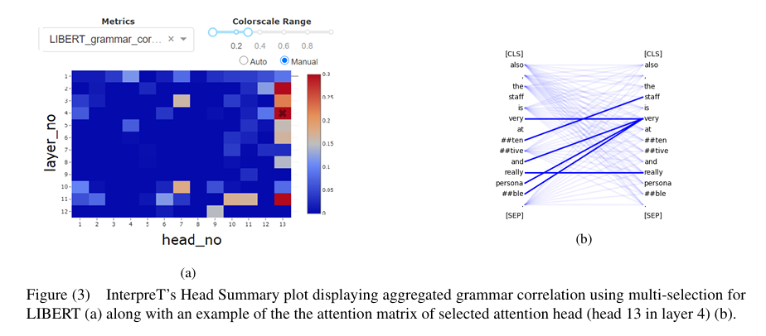
Visualizing the domain GAP: InterpreT is used to visualize how the incorporation of dependency relations in LIBERT contributes to bridging the gap between domains.

Slide 30
Grammar Correlation: A key feature of InterpreT is the addition of metrics to help identify attention heads which carry out specific functions. For analyzing LIBERT, the “grammar correlation” metric is used to identify attention heads with an affinity for detecting syntactic relations. Figure 3a
LIBERT’s head 13 shows much higher grammar correlation

Slide 31
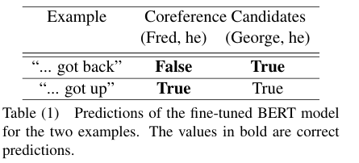
Coreference Resolution in the Winograd Schema Challenge (WSC): In this analysis of WSC, InterpreT demonstrates how information in the attention matrices and the hidden states of a Transformer can be used to understand the implicit mechanisms contributing to its ability to identify coreferent terms.

Slide 32
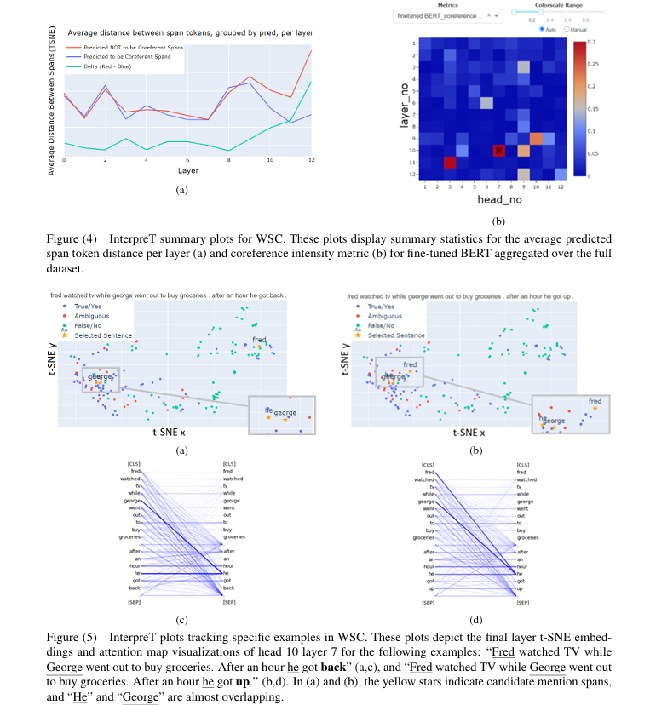
Spatial Convergence of Coreferent Terms: While analyzing WSC with InterpreT, the system’s wide-ranging capabilities gave rise to a novel observation, wherein it was discovered that a fine-tuned BERT model pushes closer together the embeddings of terms it predicts to be coreferent. Figure 4a
Figure 4a displays the average distance per layer between terms which BERT predicts to be coreferent (blue) and terms which BERT predicts to not be coreferent (red), aggregated over the full WSC dataset.

Slide 33

DODRIO: Exploring Transformer Models With Interactive Visualization

Slide 34
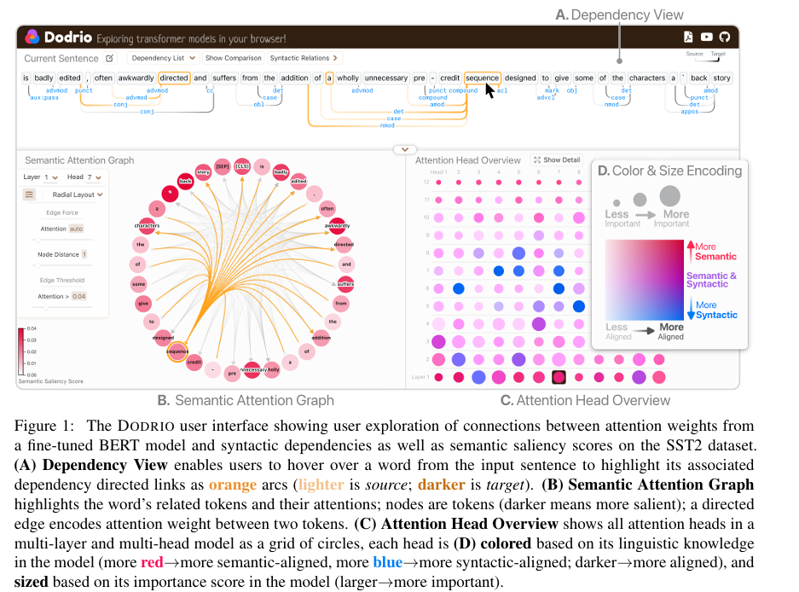

Slide 35
Attention Head Overview: This view of a grid of attention heads guides the user to inspect semantically and syntactically important heads.
more red more semantic-aligned, more blue more syntactic-aligned; darker more aligned
Syntactic Dependencies: Word relations in a sentence are important features to understand the lexical makeup of a sentence
Dependency View (Figure 1A): We visualize true dependency relations, if available, or relations tagged by the CoreNLP pipeline linked with the Semantic Attention Graph for users to investigate syntax-sensitive behavior at different attention heads.

Slide 36
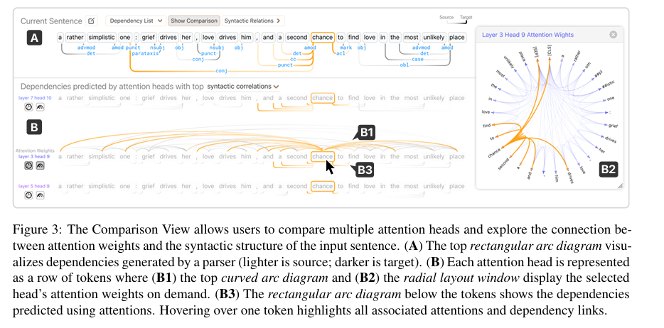

Slide 37
Comparison View (Figure 3). Understanding raw attention weights are best interpreted relative to the attention weights at other attention heads in the model.
The Comparison View enables users to examine the dependencies predicted by attention heads (Figure 3-B3)

Slide 38
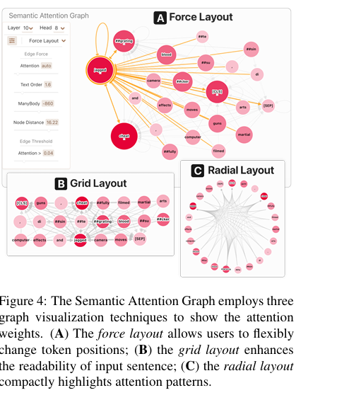
Semantic Attention Graph: Users can primarily use this interactive graph view to inspect semantically significant attention heads, as defined by the Attention Head Overview.

Slide 39
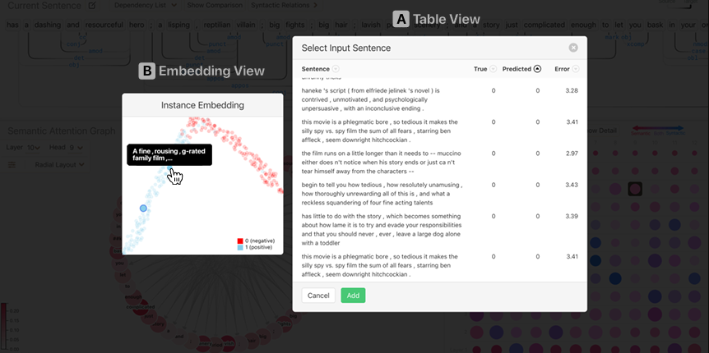
Instance Selection View
The Embedding View (Figure S1-A) uses UMAP (McInnes et al., 2018) to project text instance’s model representation computed by concatenating the last four hidden state layers of BERT to a 2D space and visualizes it with a scatter plot.
The Table View (Figure S1-B) allows for instance selection while providing the user with instance’s true and predicted labels.

Slide 40
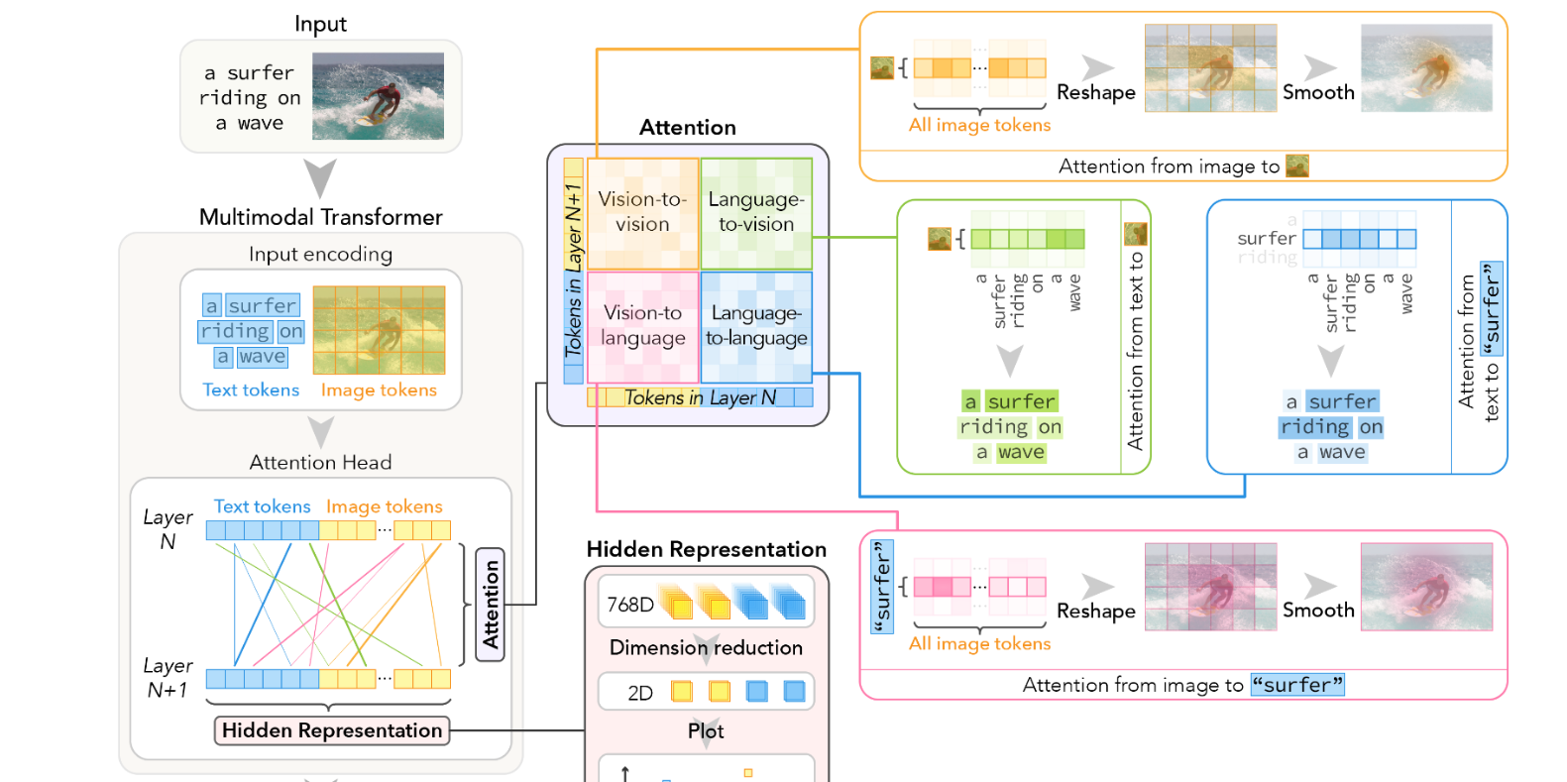
VL-InterpreT: An Interactive Visualization Tool for Interpreting Vision-Language Transformers
VL-InterpreT, differs from previous works in that it interprets various aspects of multimodal transformers in a single interface.

Slide 41
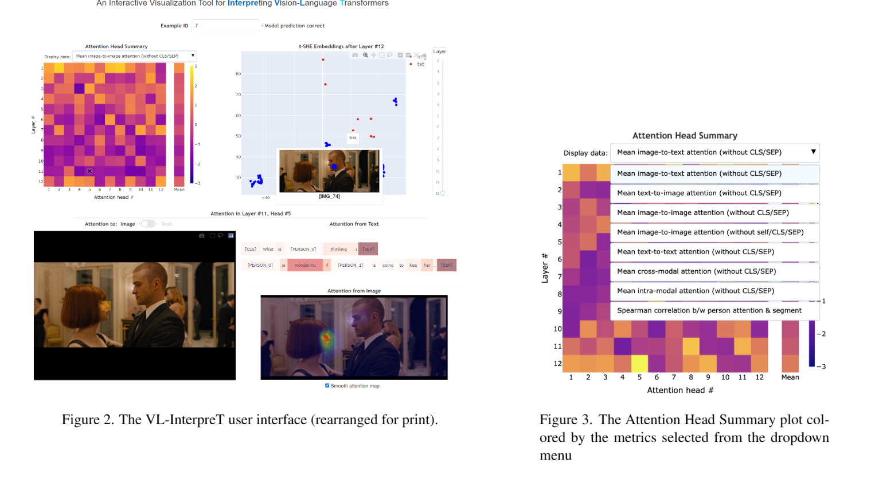

Slide 42
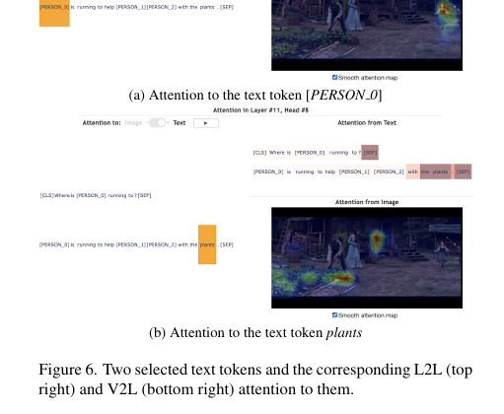
This data sample, shown in Figure 6, comprises an image showing a little girl running to a man and a woman in a garden
The question is: Where is [PERSON where [PERSON 0] running to? 0] corresponds to the little girl on the right side of the image

Slide 43
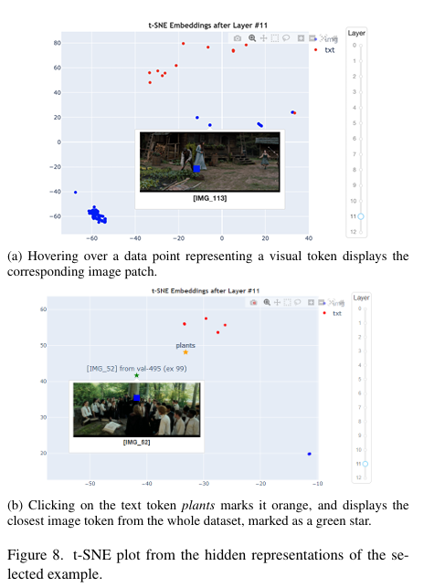
Figure 8 demonstrates the capabilities of the VL-InterpreT for visualizing hidden states. When selecting the text token plants (marked in orange) from the previous example val445 (ex 89)

Slide 44
Transformer Explainer: Interactive Visual Learning of LLM Transformers

Slide 45
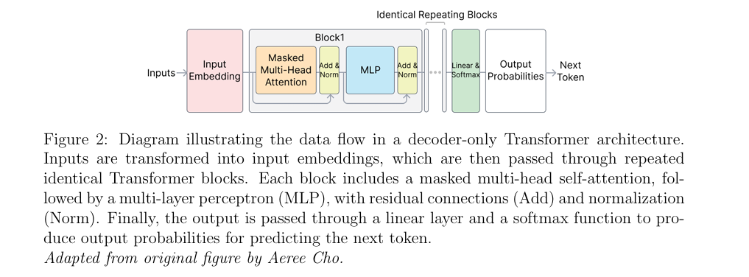
an open-source web-based interactive visualization tool designed for non-experts to learn about both the high-level model structure and low-level mathematical operations of Transformers.

Slide 46
Design Challenges & Goals
Unified View preserving Data Flow among components: Transformer architecture is too dense making it difficult for non-experts to understand. We would like to design an overview with a flow-focused representation.
Step-by-Step Visual Explanations of the mathematics behind the transformers: Transformers lack cognitive motivation and rely on high-dimensional numerical operations that are not understandable on their own. To address this challenge, we would like to adopt incremental, step-by-step visual explanations

Slide 47
Design Challenges & Goals
Real-Time Experimentation Through Direct Manipulation of Sampling Hyperparameters: we would like to design an interactive interface that allows users to directly adjust the temperature hyperparameter in real time and immediately observe its impact on next token selection.
Web-Based Tool Powered by Live Model: web-based tool that runs a live, fully functional Transformer model directly in the browser, enabling users to engage with the model directly without installations or specialized hardware.

Slide 48
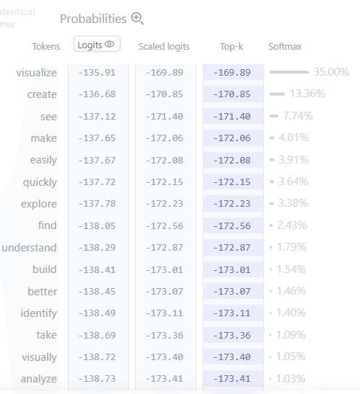
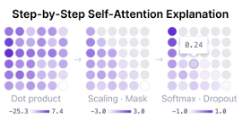
Visualization Interface of Transformer Explainer

Slide 49
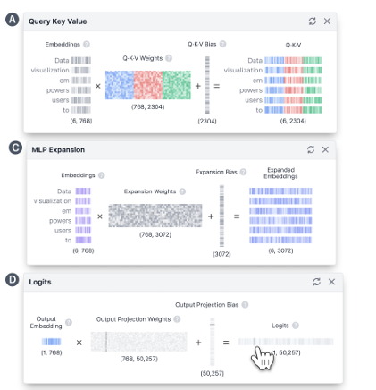
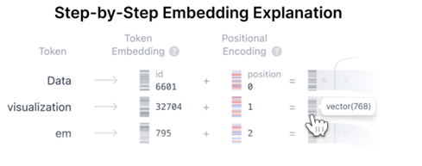
Visualization Interface of Transformer Explainer

Slide 50
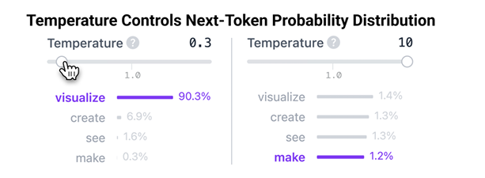
Adjustable Sampling Hyperparameter Influencing Next-Token Prediction

Slide 51
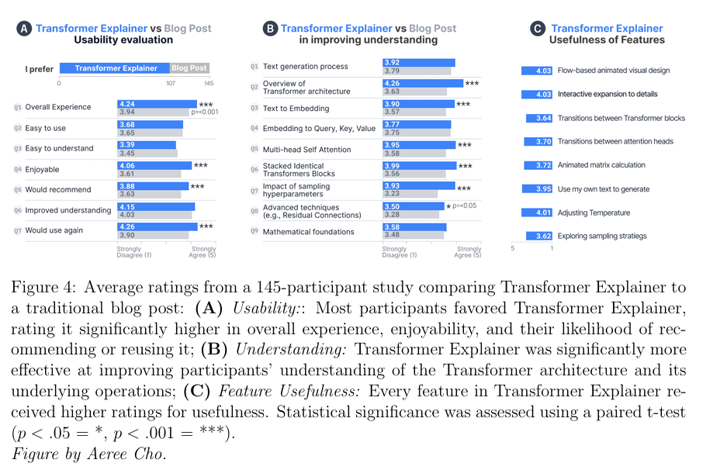
User Study
Each participant interacted with both Transformer Explainer and a widely referenced blog post explaining decoder-only Transformers (GPT-2), identified through a top Google search result.
Following each interaction, participants completed a short quiz to confirm meaningful engagement with the material.

Slide 52
Result and Design Lessons
Our findings revealed a clear preference for Transformer Explainer, with about 74% of participants preferred it over the static blog post.

Slide 53
Limitations
Interactivity increases complexity; onboarding can help
Support for deeper exploration
Further breakdown of mathematical details

Slide 54
Discussion and Future Work
Extending Support to Other Modalities
Expanding Interpretability and Visualization of Attention
Scaling to Larger Models

Slide 55
Supervisor’s feedback
Read more papers
Start developing Prototype
Be critical of the papers you’re reading

